Slide 1

CSC/CPE 138 - Computer Network Fundamentals
Network Layer: Data Plane
The presentation was adapted from the textbook: Computer Networking: A Top-Down Approach 8th edition Jim Kurose, Keith Ross, Pearson, 2020
Notes:
Version History
8.0 (May 2020)
All slides reformatted for 16:9 aspect ratio
All slides updated to 8th edition material
Use of Calibri font, rather that Gill Sans MT
Add LOTS more animation throughout
added new 8th edition material on middleboxes (and Internet arch), Net neutrality, buffering …
lighter header font

Slide 2

Network layer: “data plane” roadmap
Network layer: overview
data plane
control plane
What’s inside a router
input ports, switching, output ports
buffer management, scheduling
IP: the Internet Protocol
datagram format
addressing
network address translation
IPv6
Generalized Forwarding, SDN
match+action
OpenFlow: match+action in action
Middleboxes

Slide 3

NAT: network address translation
NAT: all devices in local network share just one IPv4 address as far as outside world is concerned
rest of
Internet
local network (e.g., home network) 10.0.0/24
10.0.0.1
138.76.29.7
10.0.0.4
10.0.0.2
10.0.0.3
all datagrams leaving local network have same source NAT IP address: 138.76.29.7, but different source port numbers
datagrams with source or destination in this network have 10.0.0/24 address for source, destination (as usual)

Slide 4
NAT: network address translation
all devices in local network have 32-bit addresses in a “private” IP address space (10/8, 172.16/12, 192.168/16 prefixes) that can only be used in local network
advantages:
just one IP address needed from provider ISP for all devices
can change addresses of host in local network without notifying outside world
can change ISP without changing addresses of devices in local network
security: devices inside local net not directly addressable, visible by outside world

Slide 5
NAT: network address translation
implementation: NAT router must (transparently):
outgoing datagrams: replace (source IP address, port #) of every outgoing datagram to (NAT IP address, new port #)
remote clients/servers will respond using (NAT IP address, new port #) as destination address
remember (in NAT translation table) every (source IP address, port #) to (NAT IP address, new port #) translation pair
incoming datagrams: replace (NAT IP address, new port #) in destination fields of every incoming datagram with corresponding (source IP address, port #) stored in NAT table

Slide 6
NAT: network address translation
NAT translation table
WAN side addr LAN side addr
2: NAT router changes datagram source address from 10.0.0.1, 3345 to 138.76.29.7, 5001,
updates table
1: host 10.0.0.1 sends datagram to 128.119.40.186, 80
138.76.29.7, 5001 10.0.0.1, 3345
…… ……
S: 10.0.0.1, 3345
D: 128.119.40.186, 80
10.0.0.1
1
2
S: 138.76.29.7, 5001
D: 128.119.40.186, 80
10.0.0.4
10.0.0.2
138.76.29.7
S: 128.119.40.186, 80
D: 10.0.0.1, 3345
4
S: 128.119.40.186, 80
D: 138.76.29.7, 5001
3
10.0.0.3
3: reply arrives, destination address: 138.76.29.7, 5001

Slide 7
NAT: network address translation
NAT has been controversial:
routers “should” only process up to layer 3
address “shortage” should be solved by IPv6
violates end-to-end argument (port # manipulation by network-layer device)
NAT traversal: what if client wants to connect to server behind NAT?
but NAT is here to stay:
extensively used in home and institutional nets, 4G/5G cellular nets

Slide 8
IPv6: motivation
initial motivation: 32-bit IPv4 address space would be completely allocated
additional motivation:
speed processing/forwarding: 40-byte fixed length header
enable different network-layer treatment of “flows”

Slide 9
IPv6 datagram format
flow label: identify datagrams in same "flow.” (concept of “flow” not well defined).
32 bits
priority: identify priority among datagrams in flow
ver
pri
flow label
payload len
next hdr
hop limit
source address
(128 bits)
128-bit
IPv6 addresses
destination address
(128 bits)
payload (data)
What’s missing (compared with IPv4):
no checksum (to speed processing at routers)
no fragmentation/reassembly
no options (available as upper-layer, next-header protocol at router)

Slide 10
Transition from IPv4 to IPv6
not all routers can be upgraded simultaneously
no “flag days”
how will network operate with mixed IPv4 and IPv6 routers?
tunneling: IPv6 datagram carried as payload in IPv4 datagram among IPv4 routers (“packet within a packet”)
tunneling used extensively in other contexts (4G/5G)
IPv4 header fields
IPv6 header fields
IPv4 payload
IPv4 source, dest addr
IPv6 source dest addr
UDP/TCP payload
IPv6 datagram
IPv4 datagram

Slide 11
Tunneling and encapsulation
Ethernet connecting two IPv6 routers:
A
B
Ethernet connects two IPv6 routers
E
F
IPv6
IPv6
IPv6
IPv6
IPv6 datagram
Link-layer frame
The usual: datagram as payload in link-layer frame
IPv4 network connecting two IPv6 routers
A
B
E
F
IPv6
IPv6/v4
IPv6/v4
IPv6
IPv4 network

Slide 12
Tunneling and encapsulation
Ethernet connecting two IPv6 routers:
A
B
Ethernet connects two IPv6 routers
E
F
IPv6
IPv6
IPv6
IPv6
IPv6 datagram
Link-layer frame
The usual: datagram as payload in link-layer frame
IPv4 tunnel connecting two IPv6 routers
A
B
IPv4 tunnel
connecting IPv6 routers
E
F
IPv6
IPv6/v4
IPv6/v4
IPv6
IPv6 datagram
IPv4 datagram
tunneling: IPv6 datagram as payload in a IPv4 datagram

Slide 13
Tunneling
A
B
IPv4 tunnel
connecting IPv6 routers
E
F
logical view:
IPv6
IPv6/v4
IPv6/v4
IPv6
A
B
C
D
E
F
physical view:
IPv6
IPv6/v4
IPv4
IPv4
IPv6/v4
IPv6
flow: X
src: A
dest: F
data
src:B
dest: E
src:B
dest: E
src:B
dest: E
flow: X
src: A
dest: F
data
Flow: X
Src: A
Dest: F
data
Flow: X
Src: A
Dest: F
data
Flow: X
Src: A
Dest: F
data
Note source and destination addresses!
A-to-B:
IPv6
B-to-C:
IPv6 inside
IPv4
B-to-C:
IPv6 inside
IPv4
B-to-C:
IPv6 inside
IPv4
E-to-F:
IPv6

Slide 14
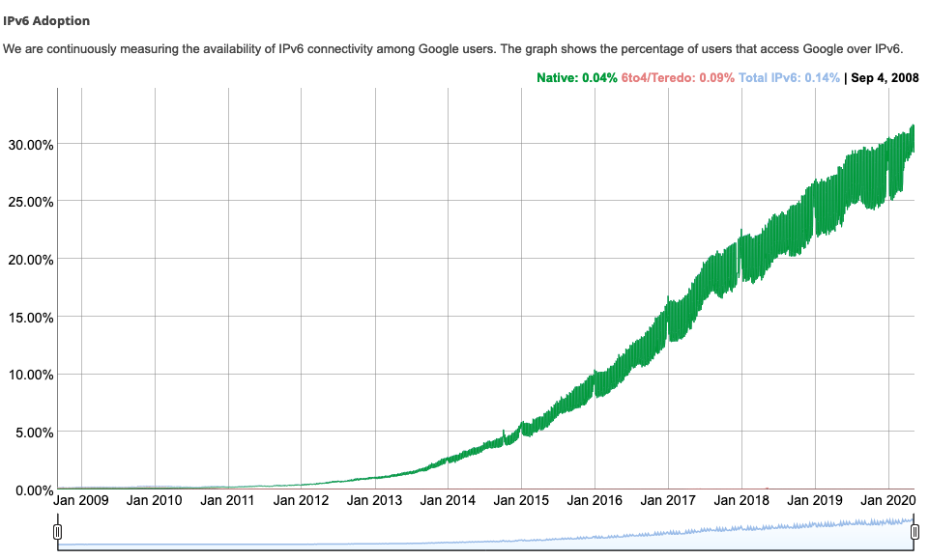
IPv6: adoption
Google¹: ~ 30% of clients access services via IPv6
NIST: 1/3 of all US government domains are IPv6 capable
¹ https://www.google.com/intl/en/ipv6/statistics.html

Slide 15
IPv6: adoption
Google¹: ~ 30% of clients access services via IPv6
NIST: 1/3 of all US government domains are IPv6 capable
Long (long!) time for deployment, use
25 years and counting!
think of application-level changes in last 25 years: WWW, social media, streaming media, gaming, telepresence, …
Why?
¹ https://www.google.com/intl/en/ipv6/statistics.html

